Slide 1

Biostatistics DAY 4: Big Data & Dimension Reduction
Justin Whalley

Slide 2
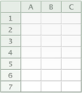
WHOLE GENOME gene expression
donor
genes
Non-treated, ‘naive’,
monocytes
Notes:
In this dataset we have:
228 donors, ~15000 gene expression values

Slide 3
WHOLE GENOME gene expression
donor
genes
Naive
IFNγ treated
monocytes
Notes:
Gene expression for the monocytes treated by inteferon-gamma – proteins that help regulated the immune system.

Slide 4
WHOLE GENOME gene expression
donor
genes
Naive
IFNγ
Lipopolysaccharide (LPS) treated
monocytes (2 hour wait)
Notes:
Major component of the outer wall of gram negative bacteria, which our body registers as a toxin and elicits a strong immune response.

Slide 5
donor
WHOLE GENOME gene expression
genes
Naive
IFNγ
LPS 2h
Lipopolysaccharides (LPS) treated
monocytes (24 hour wait)
5
Notes:
Also gene expression after 1 day of being treated.

Slide 6
WHOLE GENOME gene expression
donor
genes
Fairfax et al. Innate immune activity conditions the effect of regulatory variants upon monocyte
gene expression. Science, 2014.
Naive
IFNγ
Treatment
LPS 2h
LPS 24h
Notes:
So we have a dataset for 912 samples, gene expression data for ~15,000 genes.

Slide 7
whole genome GENE expression
Notes:
No doubt there is high redundancy amongst the samples, so reducing them from ~15000 to a smaller number could be really helpful into interpreting the dataset (in this case for projecting the gene expression and genes into one value for each sample for each principal component).

Slide 9
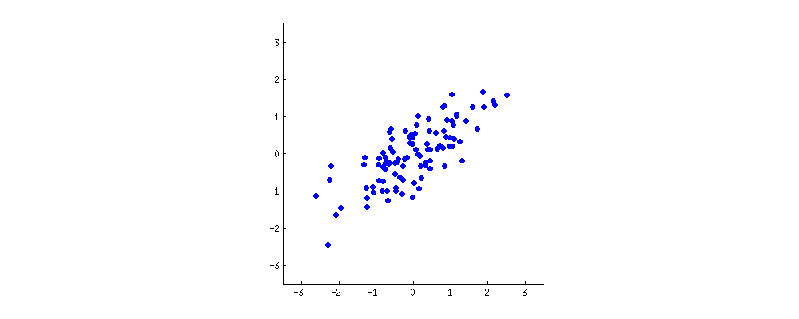
PCA: defining components
https://stats.stackexchange.com/questions/2691/making-sense-of-principal-component-analysis-eigenvectors-eigenvalues
Notes:
Looking at two characteristics of a our dataset (x and y). Want to reduce it from 2D to 1D.
A new property can be constructed by drawing a line through the centre of this cloud and projecting all points onto this line. This new property will be given by a linear combination w1x+w2y, where each line corresponds to some particular values of w1 and w2.

Slide 10
PCA: defining components
https://stats.stackexchange.com/questions/2691/making-sense-of-principal-component-analysis-eigenvectors-eigenvalues
Notes:
PCA will find the "best" line according to two different criteria of what is the "best". First, the variation of values along this line should be maximal. Pay attention to how the "spread" (we call it "variance") of the red dots changes while the line rotates; can you see when it reaches maximum? Second, if we reconstruct the original two characteristics (position of a blue dot) from the new one (position of a red dot), the reconstruction error will be given by the length of the connecting red line. Observe how the length of these red lines changes while the line rotates; can you see when the total length reaches minimum?

Slide 11
PCA on highly correlated data
Notes:
When we have a high correlation, reducing the dimensions makes sense (in this case the PCA component one explains a high percentage of variance of the dataset).

Slide 12
PCA on uncorrelated data
Notes:
However when we have low level of correlation, we are less successful in reducing the dimensions, in this case both components tend to explain the same amount of variance of the dataset.
We rarely would use PCA on a two dimensional dataset, lets look instead a gene expression experiment.

